Slide 1
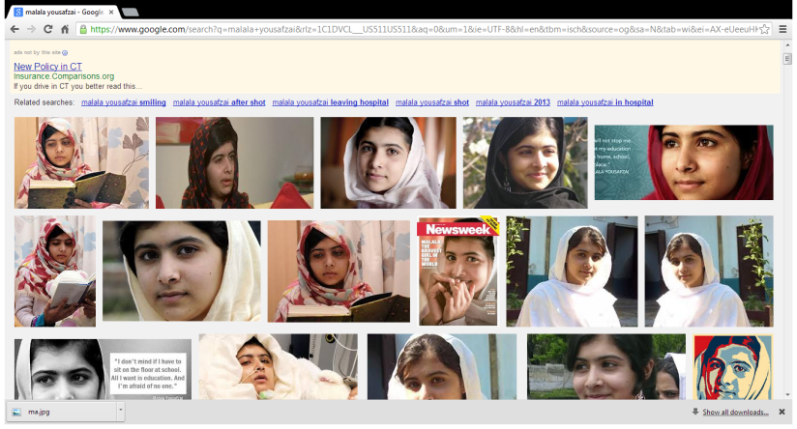
“Malala”
By: Hannah

Slide 2
For the start…
(Click on the audio)
Malala Yousafzai is a Pakistani school pupil and education activist from the town of Mingora in the Swat District of Pakistan's Khyber Pakhtunkhwa province, and the youngest nominee for the Nobel Peace Prize in history.
( I will explain more in depth later.

Slide 3
What happened to her??
At 15 years old, a Taliban gunman boarded her school bus in northwestern Pakistan and shot her and two other girls, attempting to both kill Malala and, as the Taliban later said, teach a “lesson” to anyone who had the courage to stand up for education, freedom and self-determination, particularly for girls and women.

Slide 4
Why??
When Malala was 11, she began blogging for the BBC’s Urdu site, writing about her ambition to become a doctor her fears of the Taliban and her determination to not allow the Taliban — or her fear — to prevent her from getting the education she needed to realize her dreams.
Otherwise…The Taliban were not allowing girls to have an education or go to school.

Slide 5
Later in the journey..
She had been airlifted to Queen Elizabeth’s hospital in Birmingham, England..
She had became famous for advocating that girls in Pakistan be educated -- which stoked the ire of her attackers -- proved her incredible strength by enduring two operations to repair her skull and restore her hearing

Slide 6
After…
She will continue her rehabilitation at her family's temporary home in Birmingham and will visit the hospital occasionally for outpatient appointments.
She finally met teachers at her new school in Birmingham, England. She has met the pupils with whom she will learn as she starts to catch up on lost months of her schooling.
A college had renamed the school after her
But…. Girls were afraid that attending the Malala Yousafzai Post Graduate College for Women in the Taliban-dominated Swat Valley would attract the attention of fighters like the ones who gunned down Malala and two other girls on a school bus in October, according to Kamran Rehman Khan, a top official in the Swat Valley.

Slide 7
Globally
Angelina Jolie had given $200,000 (£131,000) to the charity set up by Malala .
Watch
http://www.youtube.com/watch?v=zARtRMj8JNE
The celebrity’s reaction:
Jolie said: "All that mattered to Malala was going to school. Here's what they [her attackers] accomplished: they shot her point-blank range in the head — and made her stronger. The brutal attempt to silence her voice made it stronger."

Slide 8
More to come…
http://www.youtube.com/watch?v=YzzWoXt-Y1Y
Watch the video. The link is up above. This video is important and relevant. It basically sums up everything about Malala.

Slide 9
“I am Malala”
The Pakistani teenager who survived an assassination attempt and inspired a worldwide movement for girls' education will soon become a published author.
Malala Yousafzai, 15, says she wants her book, "I Am Malala," to reveal and help children across the world who still struggle to get to school.
"I want to tell my story, but it will also be the story of 61 million children who can't get education," she said in a statement released by her British publisher, Weidenfeld and Nicolson. "I want it to be part of the campaign to give every boy and girl the right to go to school. It is their basic right."
http://abcnews.go.com/International/video/malala-yousafzai-pakistani-teen-targeted-by-taliban-plans-memoir-18831276

Slide 10
Thanks for watching!!!
I hope you found this presentation entertaining while informative at the same time. Now you have been informed and know more about Malala
Extra fact for you: Malala has been included in the list of top 100 most influential people.

